Slide 1
D.C.Generators
A Generator is a machine that converts input mechanical energy
(rotational ) to output electrical energy.
It works on the principle of faradays laws of electro magnetic induction.
Faradays first law : It is the basic law which states the principle of D.C Generator.
“ When ever a conductor cuts magnetic lines of force induced emf is produced in the conductor”

Slide 2
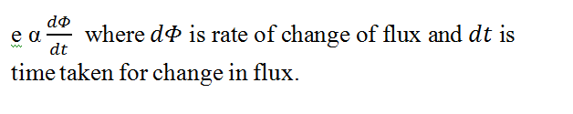
Faradays’ second law: This law gives the magnitude of emf induced in the conductor.
It states that the magnitude of induced emf is directly proportional to rate of change of flux linkages.
The direction of induced emf is given by Flemings right hand rule :
Hold your fore finger, middle finger and thumb of right hand perpendicular to each other .
If thumb points direction of rotation of conductor , fore finger direction of magnetic field , then middle finger points direction of induced emf.

Slide 3
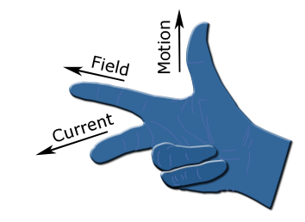
The Thumb represents the direction of Motion of the conductor.
The First finger (four finger) represents direction of magnetic field
The Second finger (Middle finger) represents direction of induced emf.

Slide 4
The nature of induced emf is given by lenzs’ law:
The direction of induced E.M.F in a coil (conductor) is such that it opposes the cause of producing it.
The following are the basic requirements to be satisfied for generation of E.M.F
1.A uniform Magnetic field
2.A System of conductors
3.Relative motion between the magnetic field and conductors

Slide 5
Constructional Details Of DC Machine
Yoke:
Rotor:
Stator:
Field electromagnets:
Pole core and pole shoe:
Brushes:
Shaft:
Armature:
Coil:
Commutator:
Bearings:

Slide 6
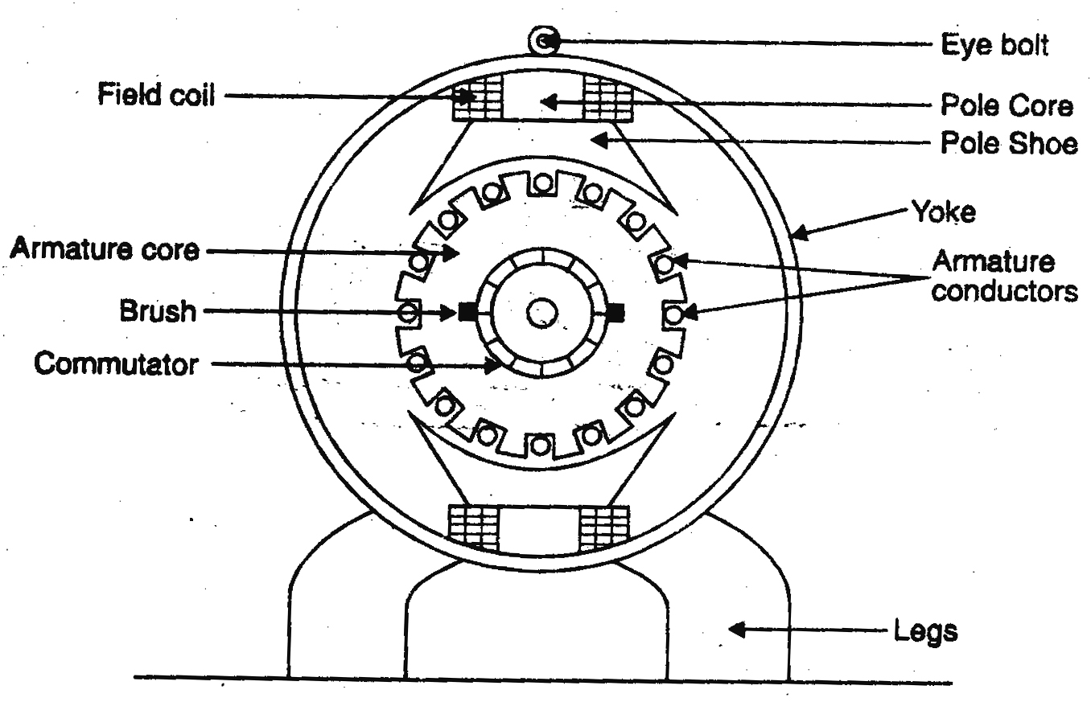
Cross section view of dc machine

Slide 7
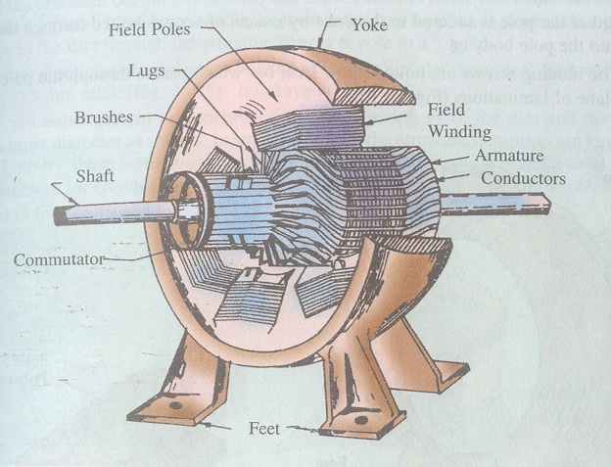
Practical Dc Machine

Slide 8
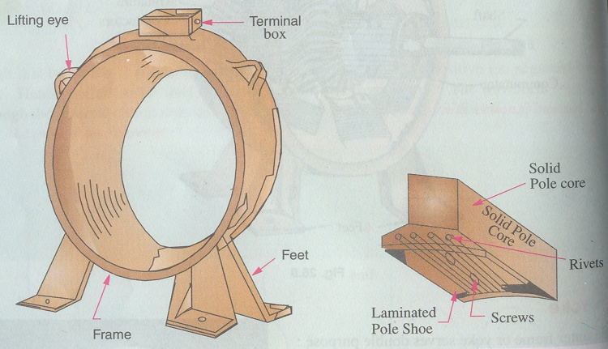
1)Yoke:-
- Acts as frame of the machine
- Mechanical support
- low reluctance for magnetic flux
- High Permeability
-- For Small machines -- Cast iron—low cost
-- For Large Machines -- Cast Steel (Rolled steel)
YOKE OF LARGE MACHINE

Slide 9
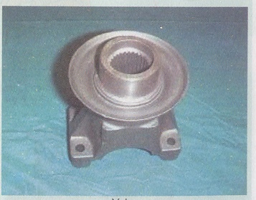
Yoke of a small dc machine

Slide 10
2)Field Magnets:-
a) Pole core (Pole body) :- --Carry the field coils
--Rectangle Cross sections
-- Laminated to reduce heat losses
--Fitted to yoke through bolts

Slide 11
Pole shoe:- Acts as support to field poles and spreads out flux in the air gap
Pole core & Pole shoe are laminated of annealed steel
(Of thickness of 1mm to 0.25 mm)

Slide 12
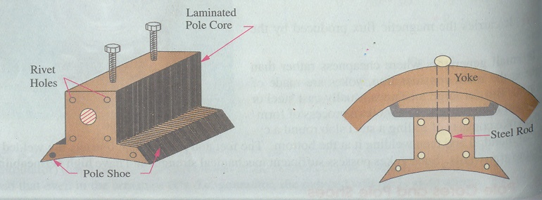

Slide 13
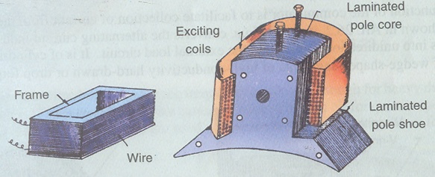
2)Field Magnets:-
To produce magnetic field. It consists of a rectangular coil of copper mounted on the pole shoe. The coil is excited when dc current is passed through it and produces magnetic flux.

Slide 14
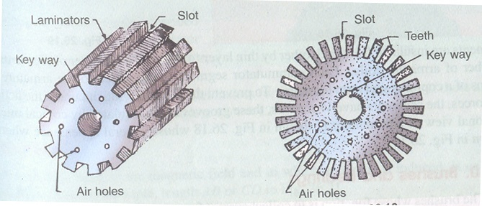
3)Armature core: It acts as an housing for armature conductors. The conductors are placed in the slots punched on the outer periphery.
It is cylindrical in shape and made up of cast iron.
It is laminated into thin sheets to reduce iron losses.

Slide 15
Armature Winding:-
It is the part which when rotated in magnetic field when placed in armature core and rotated by the prime mover . When these armature conductors cut the magnetic flux produced by the poles emf is induced in it.
These winding made of Copper (or) Aluminum and
are insulated each other

Slide 16
Commutator:--The output of dc generator is alternating in nature.
To convert this alternating emf to unidirectional emf commutator is required.
It consists of hard drawn copper bars segments insulated from each other by mica segments (insulation)
It is present armature & External circuit and acts like Rectifier to convert AC to DC
It is wedge shaped with no of commutator segments equal to no of armature conductors.
Each commutator segment is connected to one armature conductor.

Slide 17
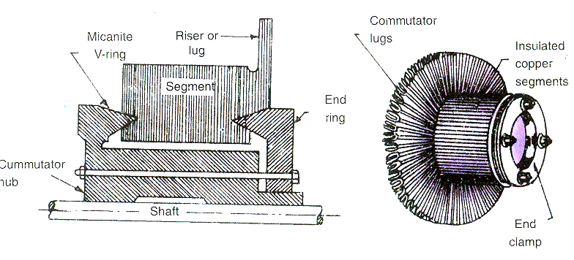

Slide 18
Brushes and brush gear:-To collect the current from commutator segments and supply to load brushes are used. They are made up of Carbon, Carbon graphite, copper.
Since the brushes slide on commutator segments there is frequent wear and tear and are frequently replaced.
Bearings:- To reduce friction between rotating parts ie prime mover and generator bearings are used.
Generally ball bearings are used.

Slide 19
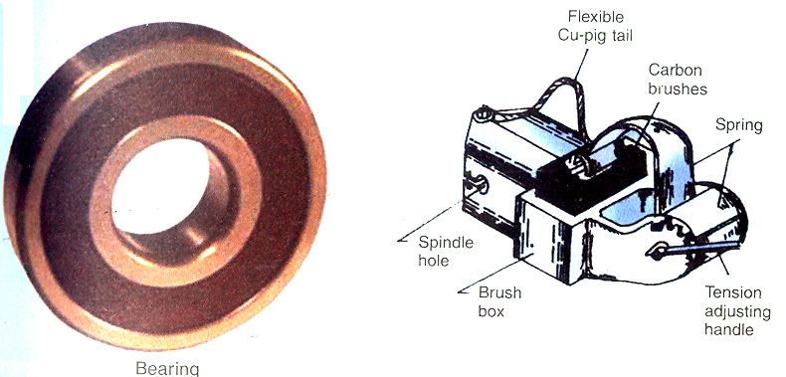

Slide 20
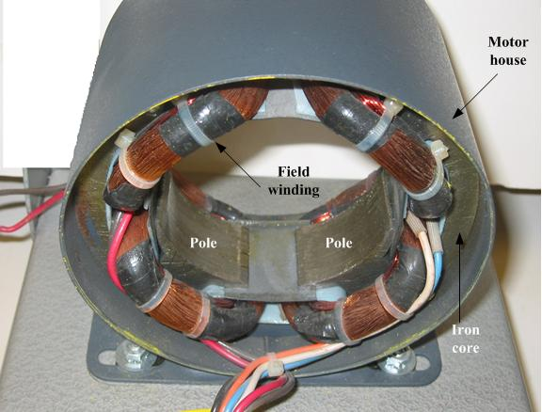

Slide 21
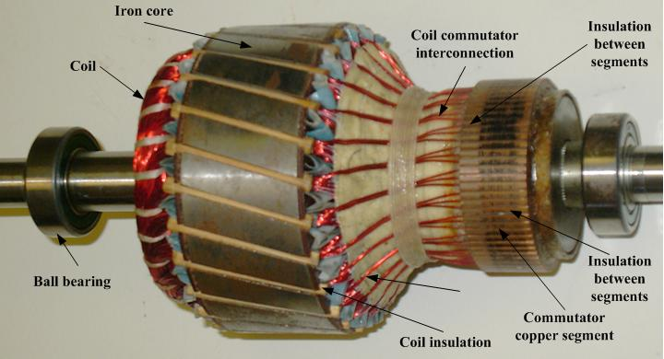
Rotor of a dc machine

Slide 22
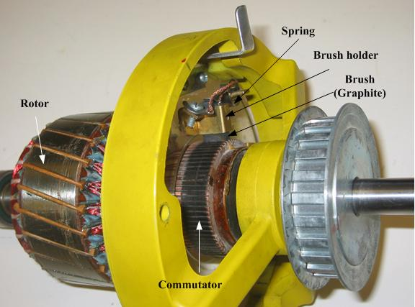
Cutaway view of a dc machine

Slide 23
Armature Winding: These are the conductors where induced emf is produced . They are made up of pure copper.
In order to obtain rated voltage and current ratings they are divided into two types:
Lap winding and Wave winding.
For high current and low voltage requirement lap winding is used
and
For high voltage and low current applications wave winding is used.

Slide 24
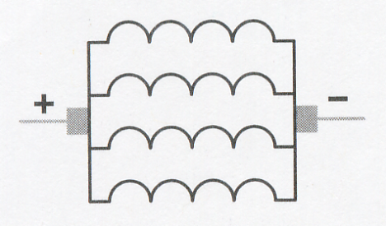
Lap Winding:
are used in machines designed for low voltage and high current
armatures are constructed with large wire because of high current
Eg: - are used is in the starter motor of almost all automobiles
The windings of a lap wound armature are connected in parallel. This permits the current capacity of each winding to be added and provides a higher operating current.
No of parallel path, A=P ; P = no. of poles

Slide 25
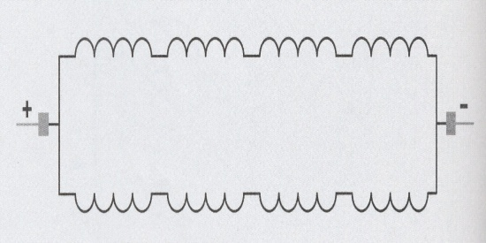
Wave winding:
are used in machines designed for high voltage and low current
their windings connected in series
When the windings are connected in series, the voltage of each winding adds, but the current capacity remains the same
are used is in the small generator.
No of parallel path, A=2,

Slide 26
Generated EMF or EMF Equation of a generator
Let Φ = flux/pole in Weber
Z =Total number of armature conductors
=No. of slot × No. of conductors/slot
P= No. of generator poles
A =No. of parallel paths in armature
N= Armature rotation in revolutions per minute (r. p. m)
E= e.m.f induced in any parallel path in armature
Generated
e.m.f E_{g}= e.m.f generated in any one of the parallel
paths i.e E
Average e.m.f generated/conductor = d Φ volt
dt

Slide 27
No. of revolutions/sec=N/ 60
∴Time for one revolution , dt= 60 /N sec
According to Faraday’s Law of electro magnetic induction
E.M.F generated/conductor = dΦ= ΦPN volts
dt 60
No. of conductors (in series) in one parallel path=
Z / A
∴E.M.F generated/path= Φ PN × Z Volts
60 A
∴Generate E.M.F, E_{g}= ΦZ N × P Volts
60 A
For
i) Wave winding A = 2
ii) Lap winding A = P

